Slide 1
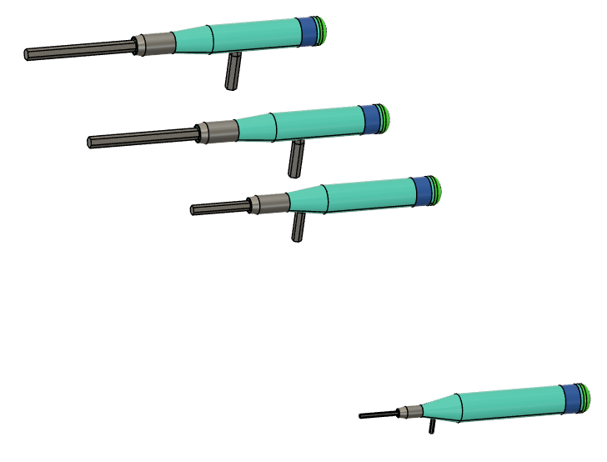
Mike’s Fusion 360 Class
Module 3 – Working with parameters
Design a set of 3D printable handles
for your allen wrench set

Slide 2
Module 3 - Parameters
Parameters discussion
Fusion 360 is a “Parametric Design System”. This means it remembers the dimensions (parameters) you use while making your design.
If you have put a dimension on a sketch, you are already using parameters. But parameters can be much more than just a number on a sketch.
If you plan your use of parameters, your can easily change one and the resulting change will ripple through the rest of your design.
Real example for this module
3D printable Allen wrench Handles

Slide 3
Types of parameters we will cover in this class
These are all in the parameters window
Basic dimensional parameters
Simple and complex equations in parameters
User parameters
Model parameters
Favorites
Equations in parameters
Referencing other dimensions (parameters)
Algebraic parameters
Functions in equations
Functions built into Fusion 360

Slide 4
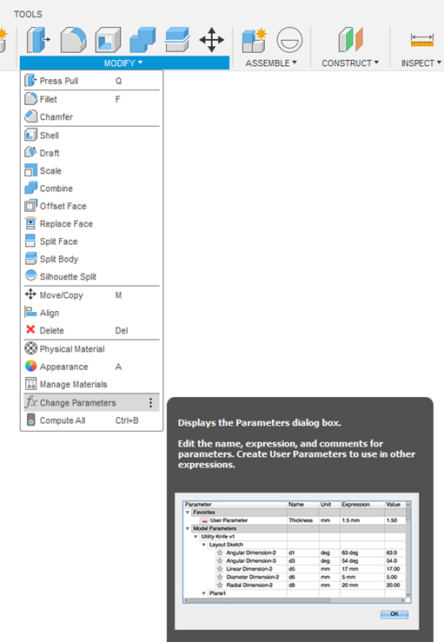
Accessing the Parameters Window
Expand the modify menu and find “Change Parameters”
Class-tip – Pin to toolbar (at least for this class)

Slide 5
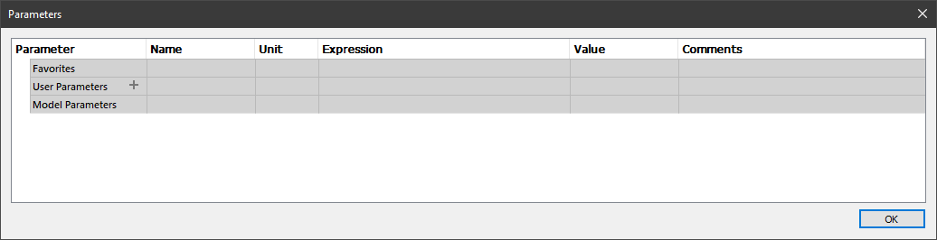
The parameters window
Favorites – Parameters you select as favorites.
User Parameters – Parameters you create
Will appear in popups
Not tied to a component
Model Parameters
Captured automatically while you are making sketches and modeling solids.
Organized by component/step

Slide 6
Equations and functions
Equations
Just type in the equation you want, no “=” needed unless you are assigning a name to a model parameter.
RED means it’s not legal (often a units issue)
Algebraic operators
+ addition
- subtraction
% floating point modulo
* multiplication
/ division
^ power
( expression delimiter
) expression delimiter
; delimiter for multiargument functions
Read about it: https://help.autodesk.com/view/fusion360/ENU/?guid=GUID-76272551-3275-46C4-AE4D-10D58B408C20

Slide 7
Functions in equations
Syntax | Expected Types | Return Type
cos(expr) | angle | unitless
sin(expr) | angle | unitless
tan(expr) | angle | unitless
acos(expr) | unitless | angle
asin(expr) | unitless | angle
atan(expr) | unitless | angle
cosh(expr) | angle | unitless
sinh(expr) | angle | unitless
tanh(expr) | angle | unitless
sqrt(expr) | any | unit^1/2
sign(expr) | unitless | Any, Return 0 if negative, 1 if positive
exp(expr) | unitless | Any, Return exponential power. For example, returns 2.688E43 for 100.
floor(expr) | unitless | ul Next lowest whole number
ceil(expr) | unitless | ul Next highest whole number
round(expr) | unitless | ul, Closest whole number
abs(expr) | any | any
max(expr1;expr2) | any | any
min(expr1;expr2) | any | any
ln(expr) | unitless | unitless
log(expr) | unitless | unitless
pow(expr1; expr2) | any, and unitless | unit^expr2
random() | unitless | unitless

Slide 8
Watch and Do
Access the parameters window
create a User Parameter called “my_width”
Value = 20mm
Close the window.
Create a sketch
Draw a rectangle.
Dimension the height with “my_height=50”. This is a named Model parameter.
Dimension the width - start typing “my_width” and note that the User Parameter pops up in a selection box as soon as you type the “m”. Also note that “my_height” does not. User Paramters will auto-complete, but Model Parameters must be fuly (and perfectly) typed to be reused.
Extrude the rectangle 100mm
Rename the extrusion on the timeline to “My named Extrusion”
Radius two edges of the extruded shape
Return to the parameter window

Slide 9
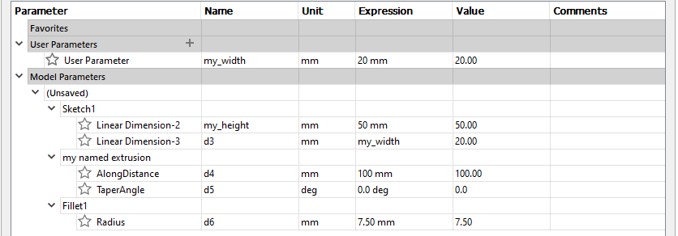
Parameters window
Note where each value showed up.
Parameters you did not name are named by Fusion - “d1”, “d2”, “d3”, etc.
Change any value and note the change in the object. (Try using different units)
Change a name in the window (and try to reuse an existing name)
Add an equation in the Expression column.

Slide 10
Watch and Do – Copying Components
Close the Parameters window
Create a new component called my component, and make it the active component.
Extrude the rectangle from the original sketch -50mm.
Create a sketch on any face of the new body and add a circle in the body.
Extrude the circle into the body (cut) by “my_width/2”.
Make the top level component the active component.
Make two copies of my_component, one using Paste and the other using Paste New.
Right click on “my component” and select Copy.
Right click in a blank space and select Paste. Move the part off the original. This is a clone of the original. Any changes to one will appear in both. The clones are designated by the “:N” in the component browser.
Right click in a blank space and select Paste New. Move the part off the original, and check the “Capture position” box. This is a recreation of the steps you used to create “my component” and is not tied to the original design. Note that this component has been named “my component (1)”

Slide 11
Watch and Do – Copying Components continued
Open the Parameters window and note the following
There is only one entry in the Model Parameters section for my_conponent.
Open the sections for my component and my component (1) and compare the dimension names.
Change the value of User Parameter my_width to 10 and note that all the bodies change.
Change the Model Parameter my_height to 60 and note that all the bodies change.
Change the Model Parameter “my component” > “Extrude 1” >”AlongDistance” to 25 and note that the clones both change

Slide 12
Paste vs Paste New Summary
 | Paste | Paste New
Basic behavior | Creates another instance of the copied component. Edits to either will change both. | Creates a new component based on the copied component. Changes to one do not affect the other.
Model Parameters
User-Named or Fusion-Named parameters | Only one model parameter section representing all instances of the component. | New section created for new component. New name create with “_N+1” appended to name, where N is the last used numeral.
User parameters | Changing the parameter affects all instances | No new parameter created. Changing the parameter changes the copied from and the Paste New component.
All this is useful because it lets you have “copies” that have some parameters in common and others that are unique to the copy. Note: this is not because Model parameters can be named, that’s just a convenience.

Slide 13
Tidbits
A warning
Changing a parameter can alter a sketch if the dimension becomes invalid with a new parameter value. Same as if you change the dimension on a sketch. But this can change when the sketch is not displayed, so beware.
Lines can disappear
circles and arcs can disappear
Deleting User parameters
F360 will not let you delete a user parameter if it is used somewhere. If it is, it will tell you the name of the dimension where it’s used, but will not tell you where it is.
Named parameters and the timeline
Once a named parameter is in the parameters table, it will stay there even if you roll the timeline back before when you named the parameter. With this knowledge you can “cheat the timeline” and use a dimension that has not “been created” yet.
Parameter Names can’t have spaces in them
If you delete the thing where a named model parameter was created, the name gets promoted to the main model parameter namespace.

Slide 14
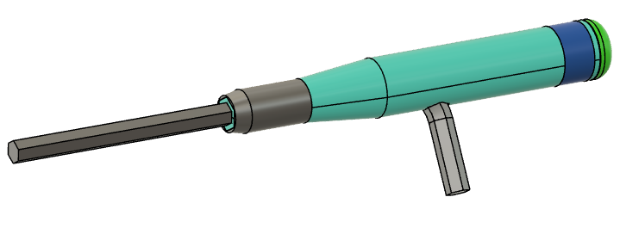
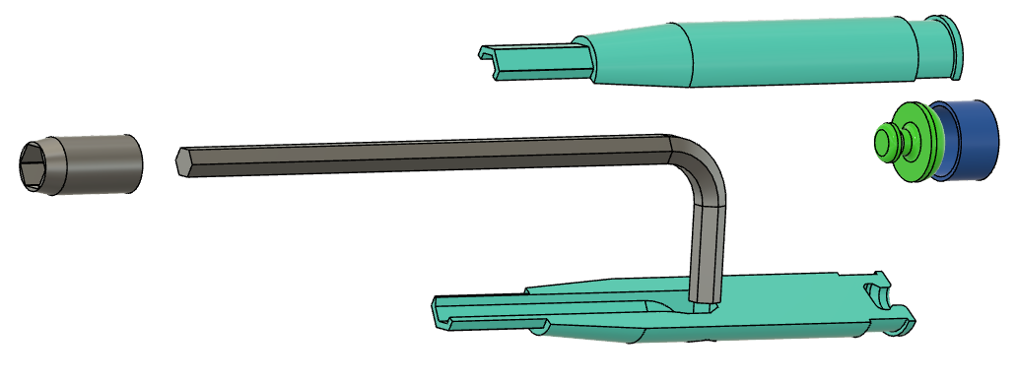
Design Example - Allen Wrench handles
Multi- part Design
Rear knob turns when using the driver.
Rear Ferrule holds the halves together
Front Ferrule holds the halves together
One side of handle
Other side of handle

Slide 15

Design Example - Allen Wrench handles
Goal – Design a set of 3D printable handles for cheapo allen wrenches. Make a family of parts.
The “family of parts” means that as the design evolves, we’ll want to be able to make two kinds of design changes:
Changes that affect all the parts (like the size and shape of the handle)
Changes that follow the needs of the “family member” (in our case the size of the allen wrench)
Sketches and components can be structured to aid in achieving this goal.

Slide 16
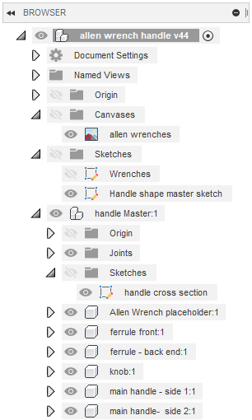
Components and Sketch structure
All parts are designed in “handle Master” component so we can eventually copy this to make new family members.
Allen wrench canvas (picture) and sketch capturing dimensions is outside “handle Master” Component.
A “handle shape master sketch” has the parts of the handle design that we may adjust after the family is made.
A “handle cross section” sketch has parts of the handle design that will change with each family part.
A “placeholder” component is designed for the part that will change. This is created before the “handle cross section” so that it can be referenced.

Slide 17
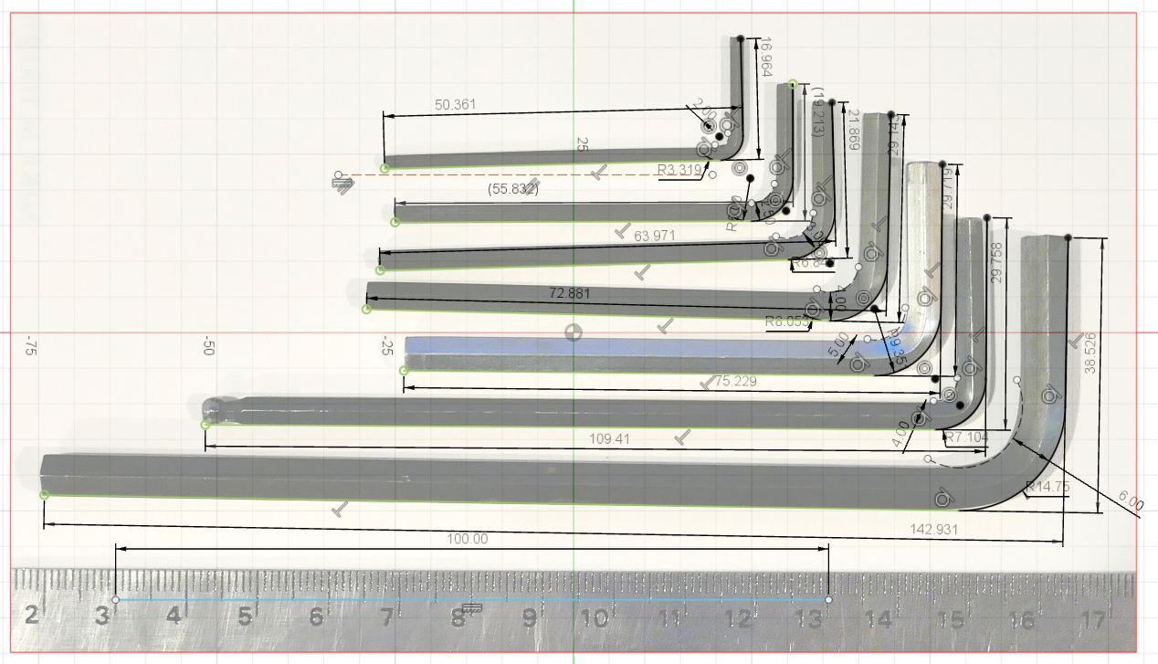
Collection of wrenches from my bench
A Scaled Canvas and a sketch

Slide 18
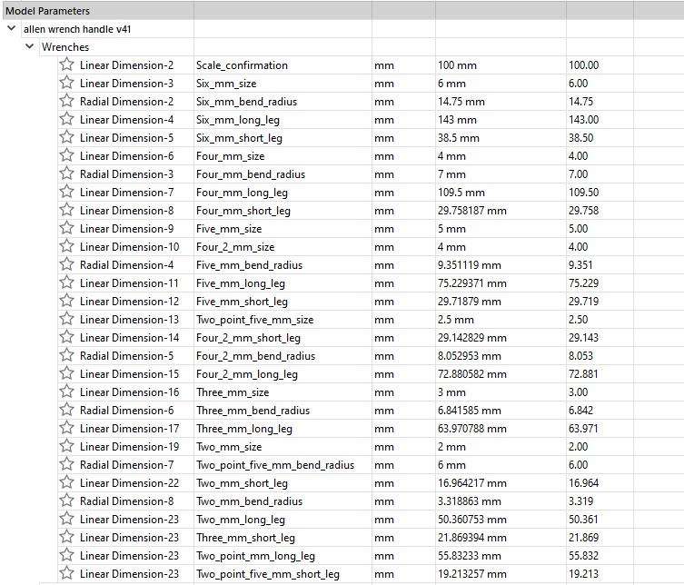
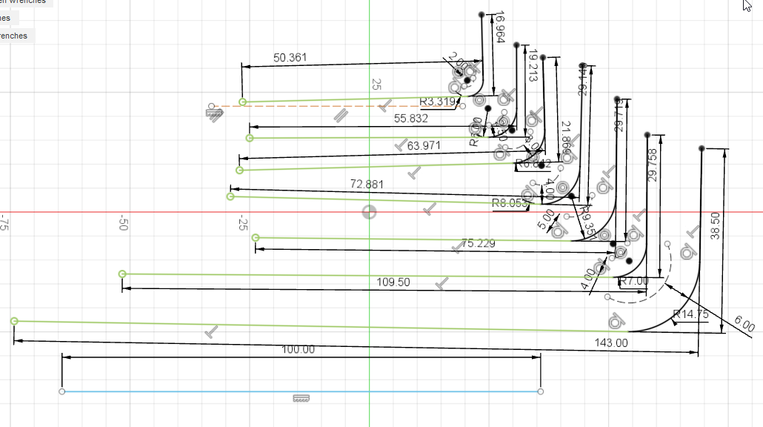
Wrenches sketch
All family members dimensions are named model parameters.
Names are nearly identical, an identifier being the only difference.

Slide 19
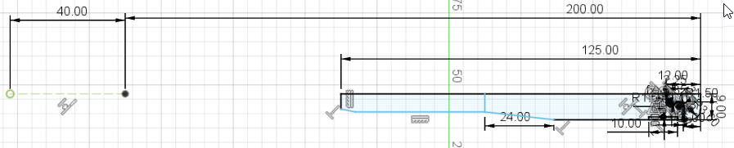
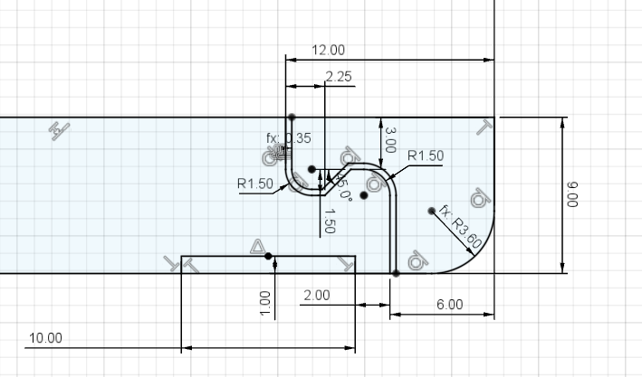
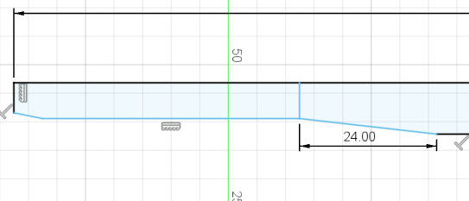
handle Master sketch
Dimensions to be established later not put in, leaving the sketch not fully constrained. Not necessary, but helpful as a guide
Dimensions common to all handles are included and named for easy adjustment later. Some are model parameters, some are User parameters.

Slide 20
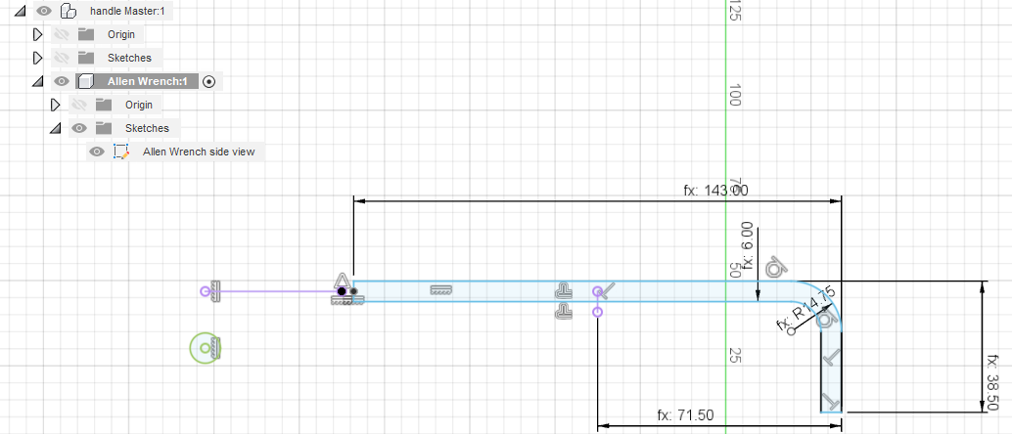
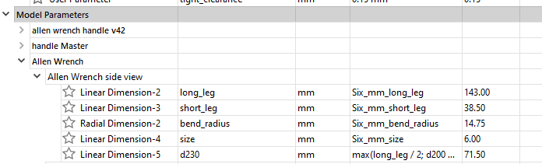
Allen Wrench side view sketch (in placeholder) (all the dimensions for this family member)
Note the similarities of the parameter names and the definition names. This is not necessary, but will make life easier later.

Slide 21
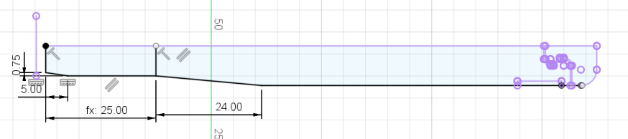
handle cross section sketch (within master handle component)
Most lines from handle master sketch projected to this sketch.
handle_taper_length
( min(25 mm; long_leg / 2 - 10 mm) )

Slide 22
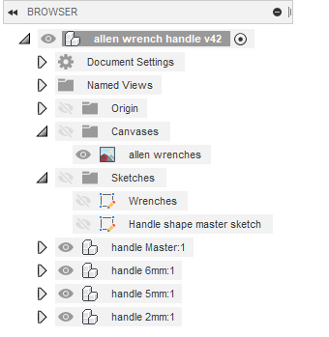
Making the family members
Right click on “handle master”, then select “Copy”.
Right click and select “Past New”, then move the new part into a new spot (and check the “Capture position” box). Note: the top level part must be selected to get “past new to appear when you right click.
Adjust the parameters for the new family member.
Change the name of the component (optional)
Change the name of “Allen Wrench” inside this part (optional)
Open parameters window, find allen wrench side view sketch, and update name references to the new wrench size.

Slide 23
After class practice
Add handles for the remaining wrenches
Make a set of handles for your own wrenches
Add some grip features on the barrel of the handle
Make the handle diameter and lengths functions of the wrench size
Take a picture of your printed handle set and email it to me.

